Slide 1


GoLift
July 6, 2016
Squat Squad
Merrick Swaffar (PO)
Nishika Tripathi (SM)
Siobhan O’Shea (SM)
Jenna Wu
Peyton Fonck

Slide 2
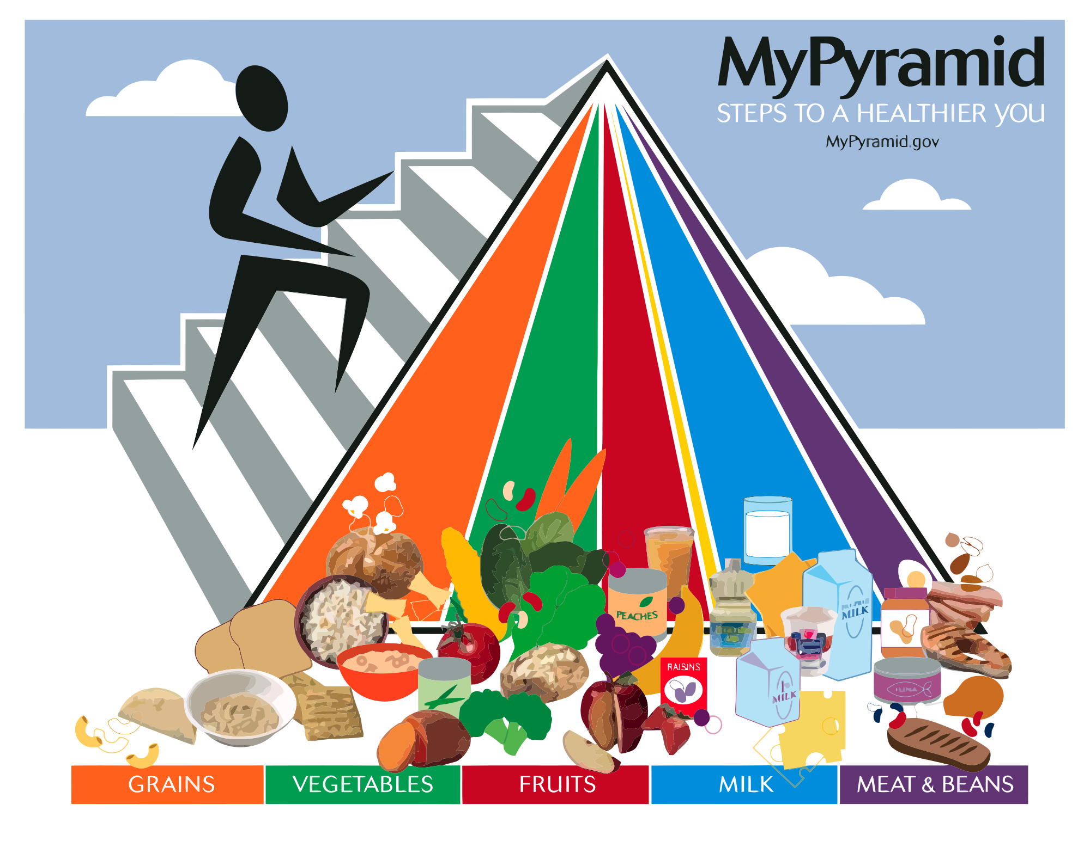
GoLift (App Description)
Our project is to create an Android app that will create workout plans for you. You will also be allowed to track your progress by entering the amount of reps, weight, or time that you did for each exercise. It also includes a feature that suggests meal plans based on desired calories and weight loss/gain.

Slide 3

GoLift (Sprint 1)
High Level Goal: Be able to make an application that
will plan workout schedules and diet plans.
As someone who wants to have a healthier lifestyle, I want
something that could help me get into the habit of being
healthier
As a person who focuses on lifting, I want to know how many reps and rests I should take for maximum gains
As someone watching their weight, I want something that could help me plan my diet
As a student, I want something that could help me fit exercise into my busy schedule

Slide 4
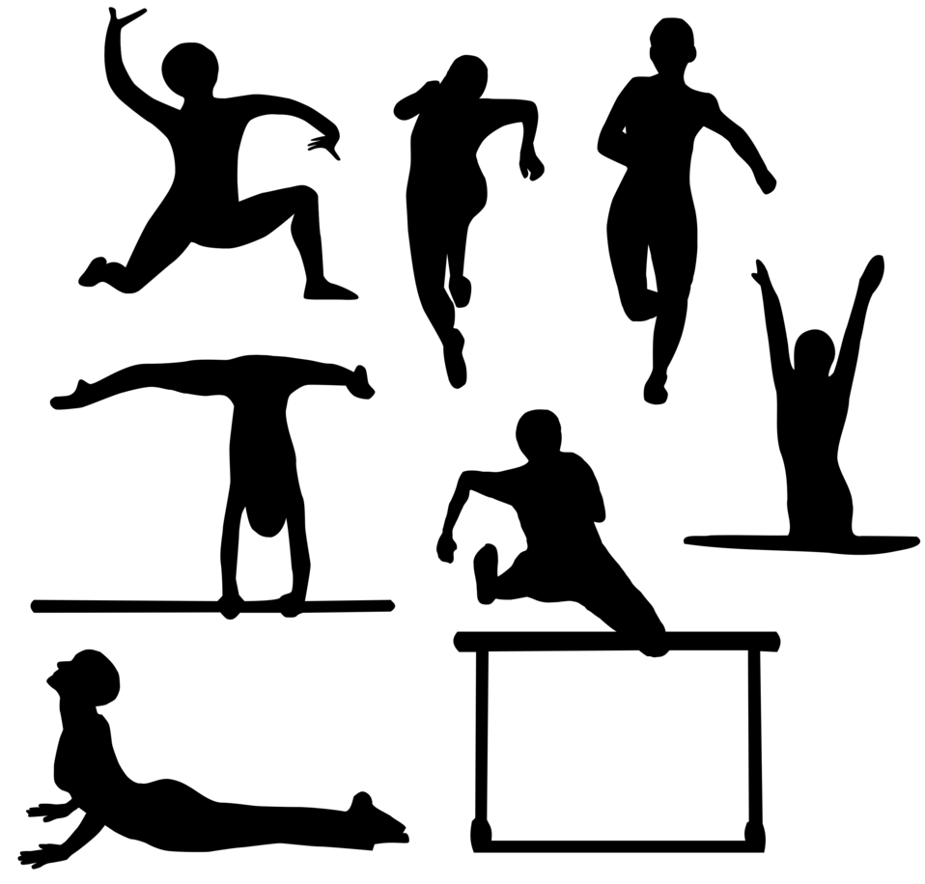
GoLift (Sprint 2)
High Level Goal: To track progress and share routines done with friends.
As an athlete, I want to be able to see how much I’ve improved with my workout regimen and maybe give suggestions on how I can improve
As someone who works out with multiple people, I want to be able to share I have planned throughout the week with others
As a trainer, I want to see the progress of my trainees and see if they are keeping up with their workouts

Slide 5

GoLift (Sprint 3)
High Level Goal: Anonymously puts results into chart so others can compare to those that have similar build.
As a person focusing on cardio, I want to compare my times with others my build
As a runner, I want to compare my times with other runners my age

Slide 6

GoLift (Features)
Our app will feature:
Personalized accounts for different workout/diet plans
Workout planner that keeps track of number of sets and reps for different exercises
Dietary planner that keeps track of meals and calories
Schedule to manage workout times

Slide 7

GoLift (Challenges)
Challenge 1: Unfamiliar with using Android Studio
Challenge 2: Managing group project development
Challenge 3: Unfamiliar with app testing/debugging
Challenge 4: Time Management
Challenge 5: Learning how to use databases

Slide 8

GoLift (Technologies Used)
Technology: Programming Languages
Java
Xml
Php
Technology: Development Environment
Android Studio
Databases

